Slide 1


@

Slide 2

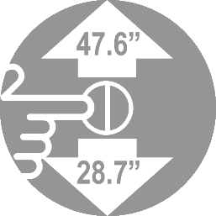
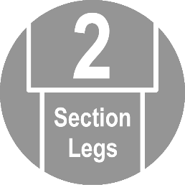
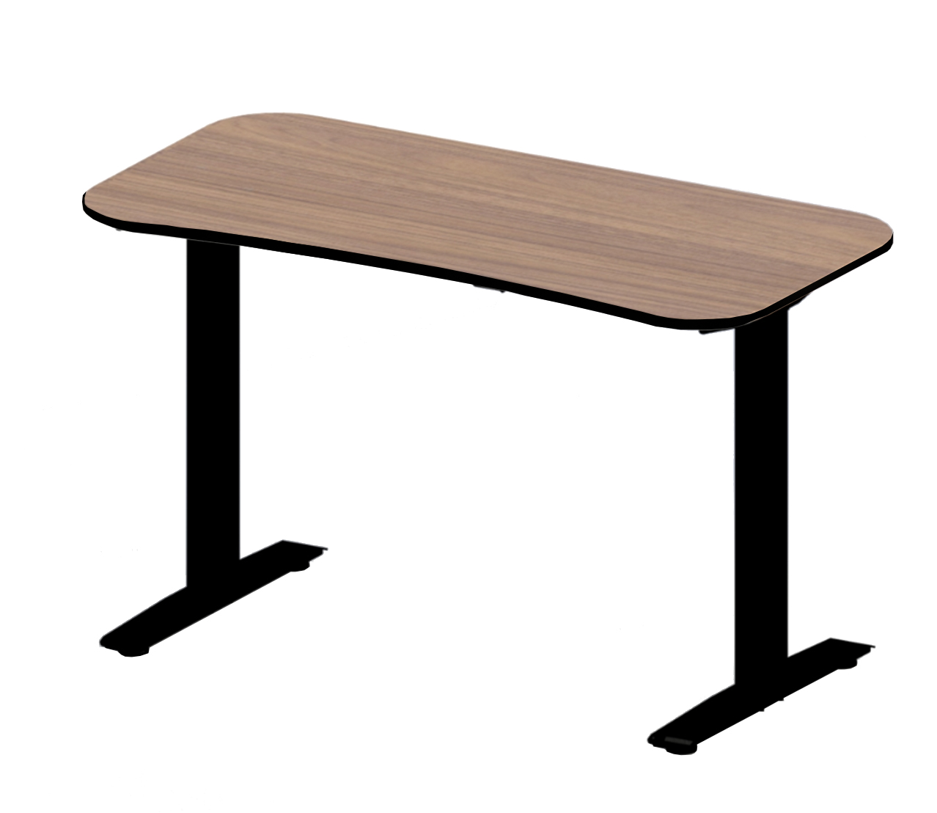


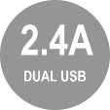


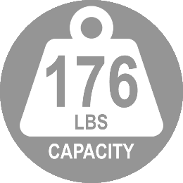
Frame Model: OFF65804
Frame + Top MSRP: $429.99
AIRLIFT® S1 Electric Height-Adjustable Desk with Table Top, 47.24" x 23.6"
Walnut Melamine with Black Banding
Specifications
Top Size: 47.24" x 23.6"
Frame Color: Black
Does not include weight of top

Slide 3
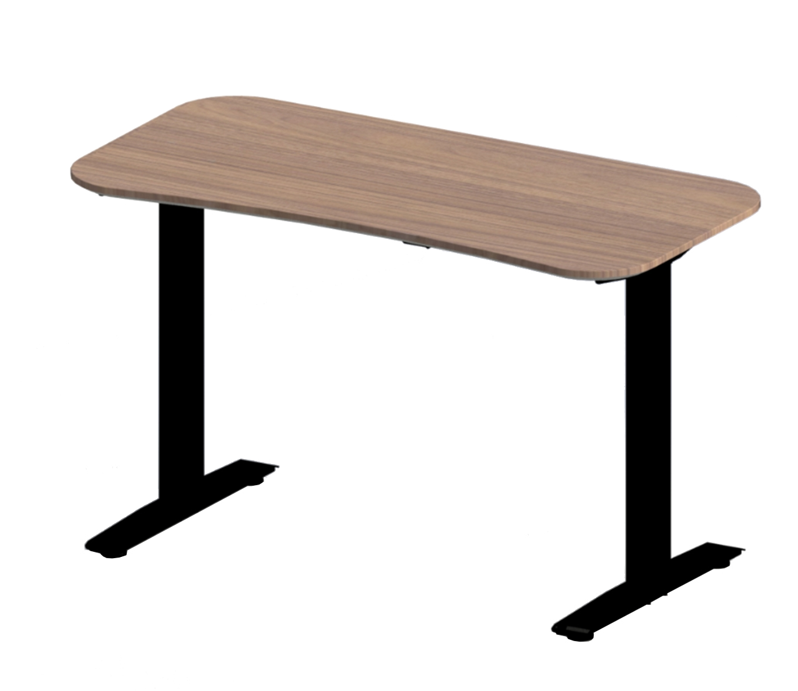
Frame Model: OFF65804
Frame + Top MSRP: $429.99
AIRLIFT® S1 Electric Height-Adjustable Desk with Table Top, 47.24" x 23.6"
Walnut Laminate
Specifications
Top Size: 47.24" x 23.6"
Frame Color: Black
Does not include weight of top

Slide 4
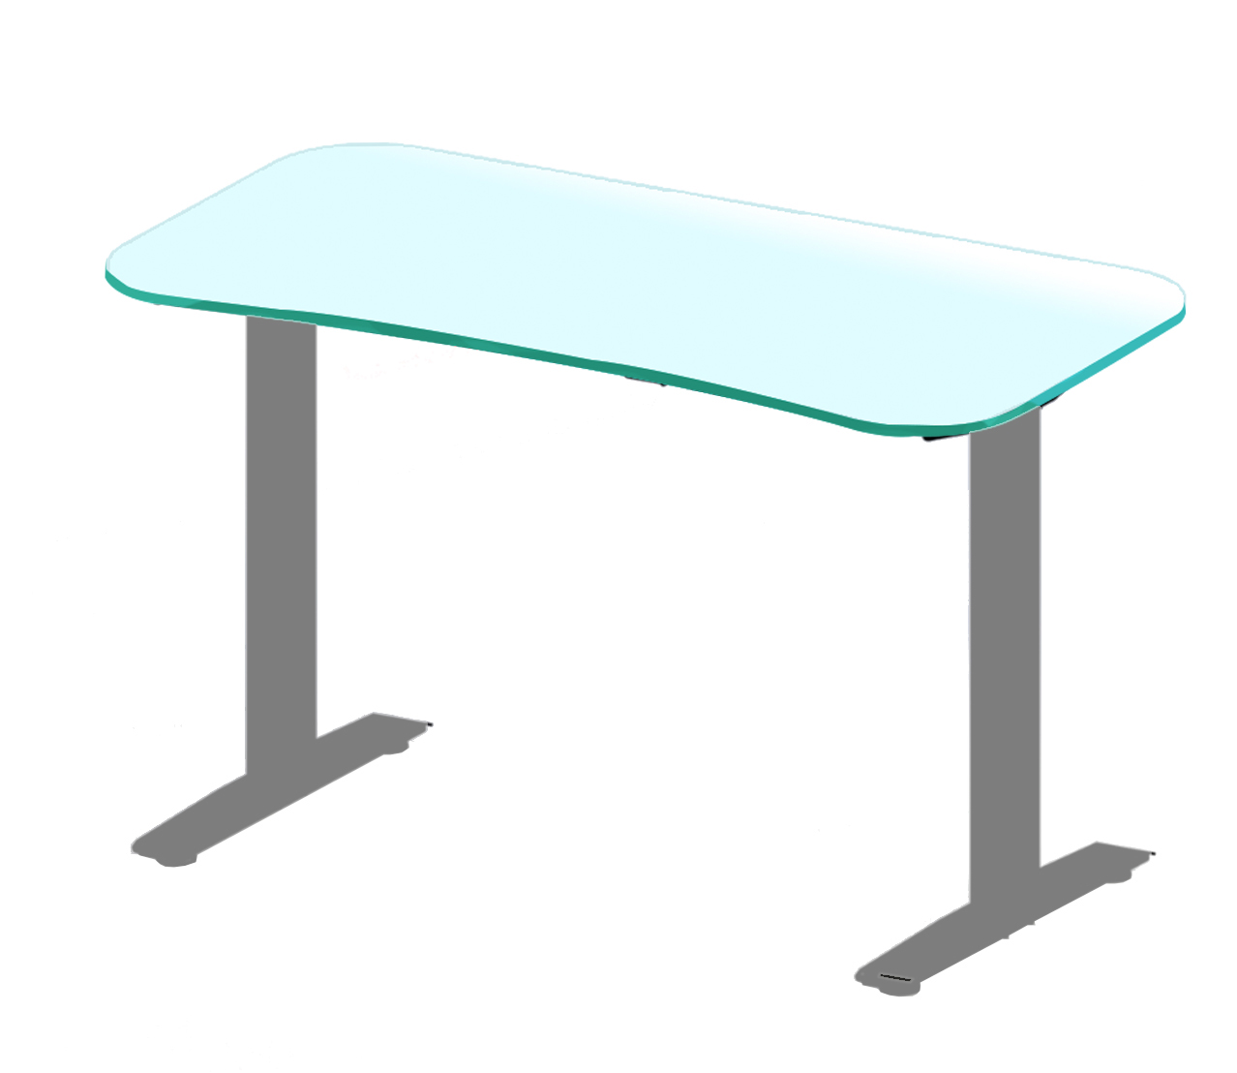
Frame Model: OFF65804
Frame + Top MSRP: $429.99
AIRLIFT® S1 Electric Height-Adjustable Desk with Table Top, 47.24" x 23.6"
Frosted Tempered Glass
Specifications
Top Size: 47.24" x 23.6"
Frame Color: Gray
Does not include weight of top

Slide 5
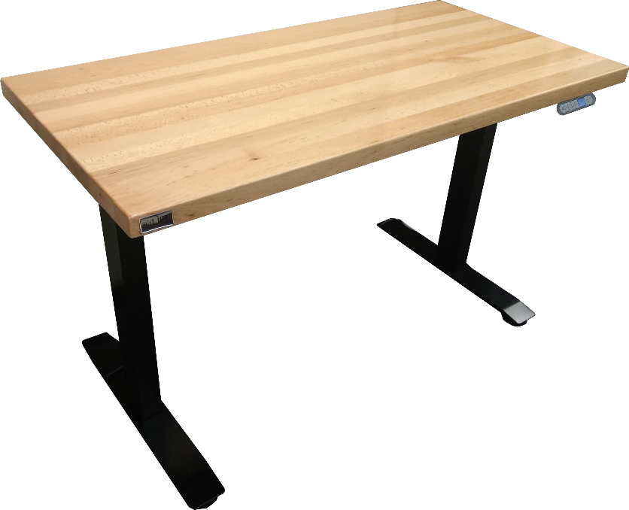
Frame Model: OFF65804
Frame + Top MSRP: $449.99
AIRLIFT® S1 Electric Height-Adjustable Desk with Table Top, 48" x 24"
Solid Beech Wood
Specifications
Top Size: 48" x 24" x 1.5" thick
Frame Color: Black
Does not include weight of top

Slide 6
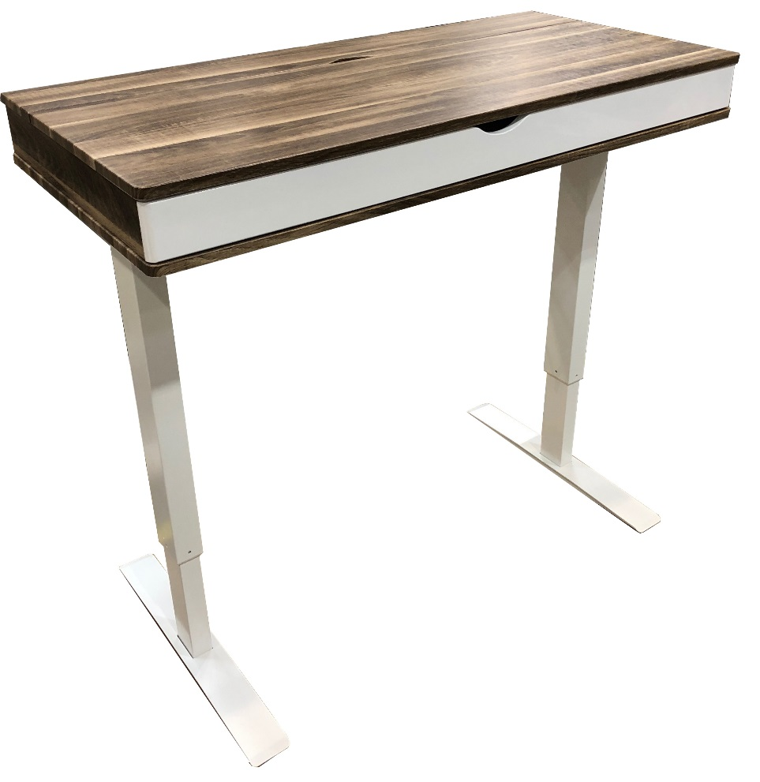
Frame Model: OFF65804
Frame + Top MSRP: $429.99
AIRLIFT® S1 Electric Height-Adjustable Standing Desk
Storage Drawer Top, 48" x 24"
Does not include weight of top

Slide 7
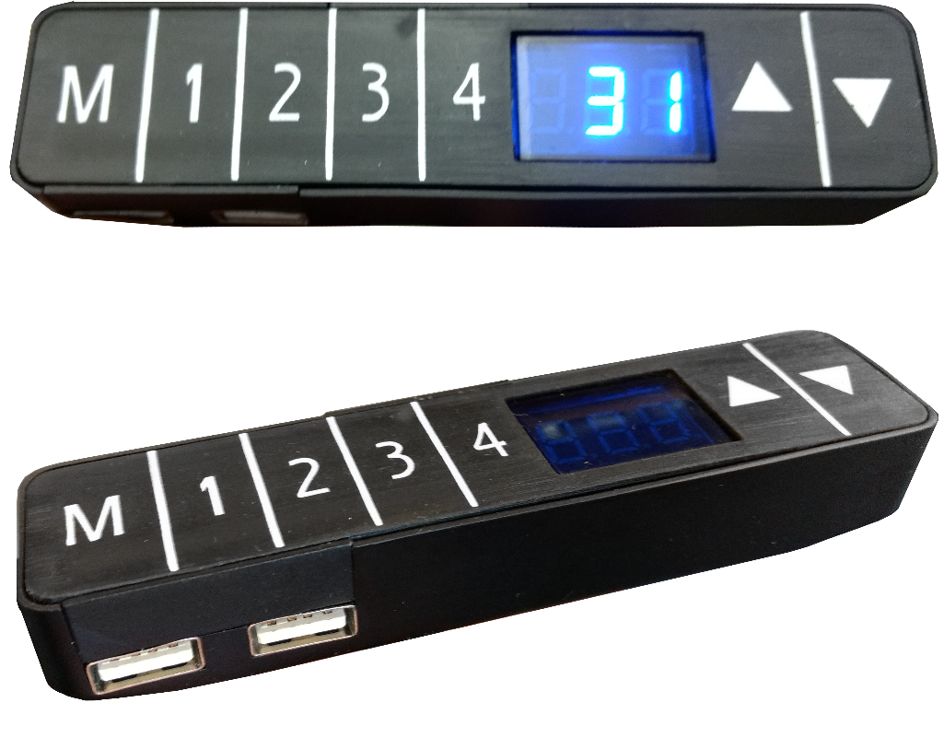
AIRLIFT® Electric Height-Adjustable Standing Desk Controller
Features
Easy button operated height adjustment
Four memory settings for reliable adjustment throughout the day
Dual USB-A ports let you charge personal devices while your work
Digital LCD display lets you know the desk's height as it moves
Specifications
Display Type: LCD
Display Color: Blue
Memory Settings: 4
USB-A Ports: 2 @ 5V/2.4A each

Slide 8
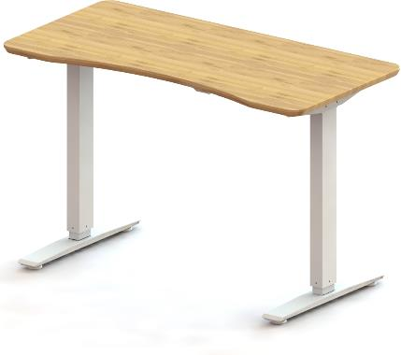



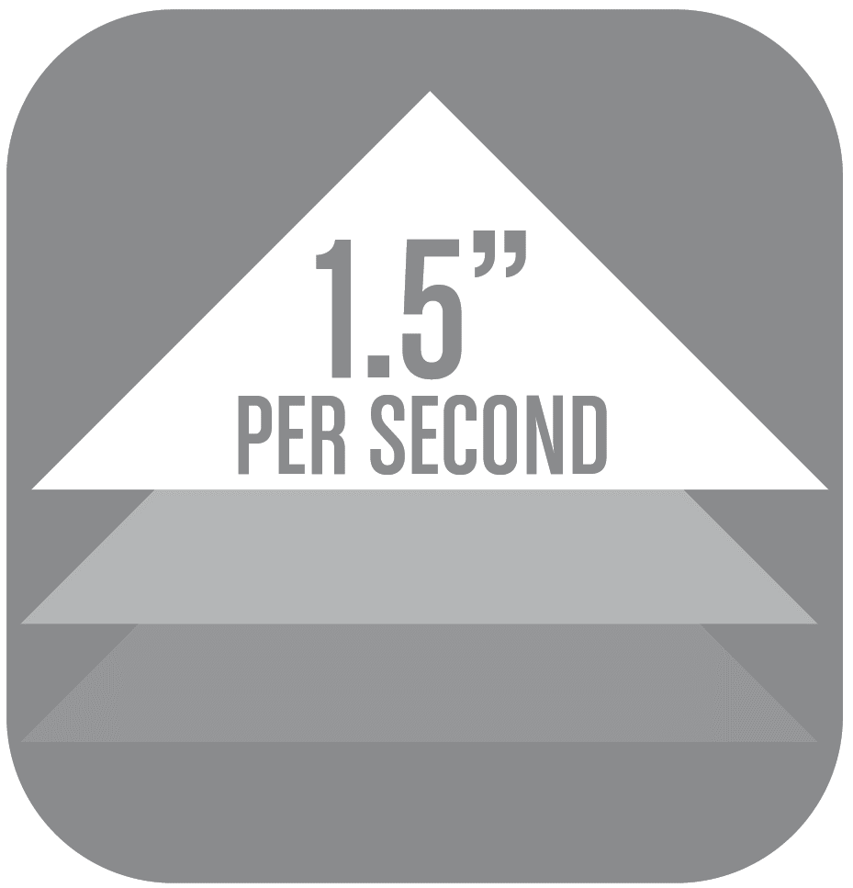

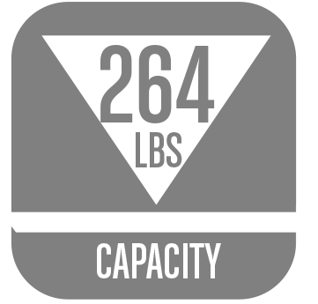
Frame Model: OFF65802
Frame + Top MSRP: $599.99
AIRLIFT® S2 Electric Height-Adjustable Standing Desk
Ergo Table Top with Beveled Bottom Edges, 60" x 30"
Bamboo
Specifications
Top Size: 60" x 30"
Frame Color: White
Does not include weight of top

Slide 9
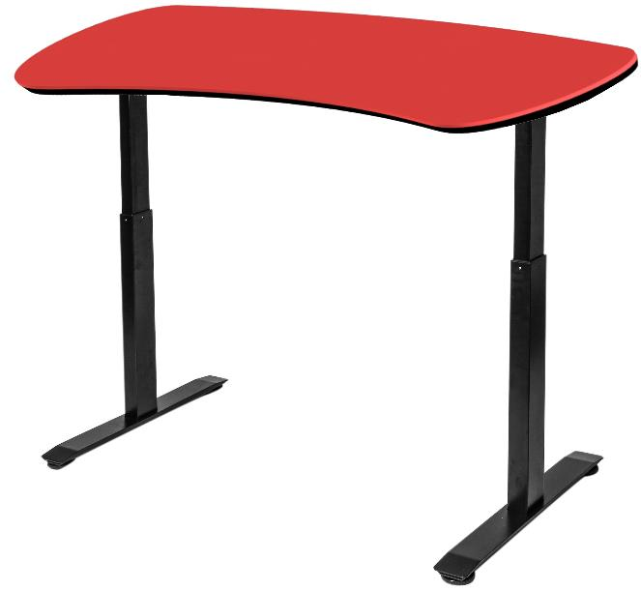
Frame Model: OFF65802
Frame + Top MSRP: $499.99
AIRLIFT® S2 Electric Height-Adjustable Standing Desk
Polyurethane Ergo Curve, 60" x 30"
Red
Specifications
Top Size: 60" x 30"
Frame Color: Black
Does not include weight of top

Slide 10
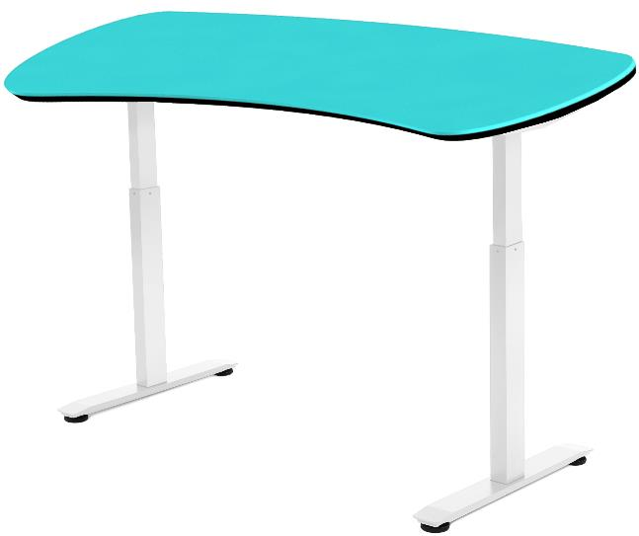
Frame Model: OFF65814
Frame + Top MSRP: $499.99
AIRLIFT® S2 Electric Height-Adjustable Standing Desk
Polyurethane Ergo Curve, 60" x 30"
Teal
Specifications
Top Size: 60" x 30"
Frame Color: White
Does not include weight of top

Slide 11
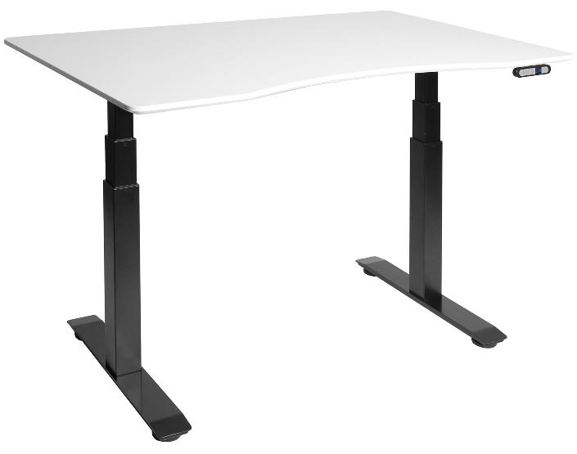

Frame Model: OFF65803
Frame + Top MSRP: $529.99
AIRLIFT® S3 Electric Height-Adjustable Standing Desk with
Ergo Table Top with Beveled Bottom Edges, 54" x 30"
Powder-Coated White
Specifications
Top Size: 54" x 30"
Frame Color: Black
Does not include weight of top

Slide 12
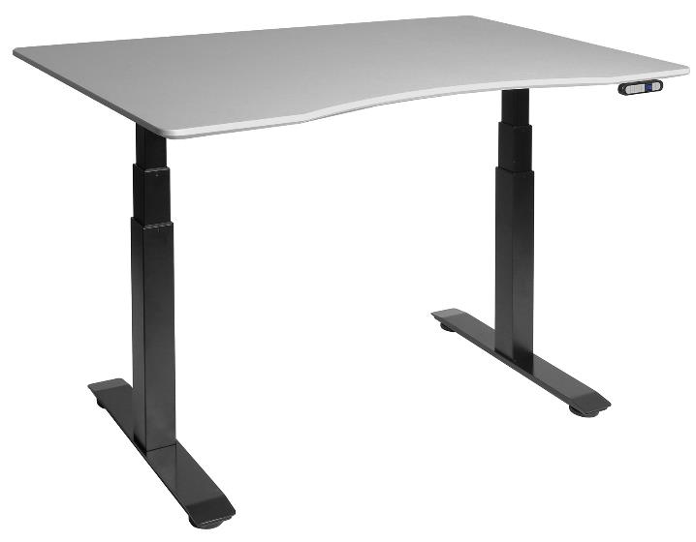
Frame Model: OFF65803
Frame + Top MSRP: $529.99
AIRLIFT® S3 Electric Height-Adjustable Standing Desk with
Ergo Table Top with Beveled Bottom Edges, 54" x 30"
Powder-Coated Cement Gray
Specifications
Top Size: 54" x 30"
Frame Color: Black
Does not include weight of top

Slide 13
Frame Model: OFF65803
Frame + Top MSRP: $529.99
Benefits of Powder-Coated MDF
Strongest resistance to scratches, scuffs and water damage in comparison to other types of laminate and veneer
Available in almost any color and finish
Evenly protects shaped MDF with no seams
Creates no unwanted VOCs (volatile organic compounds) or HAPs (hazardous air pollutants)
Impossible to delaminate
Heat-treatment kills bacteria and releases formaldehyde trapped in MDF
Water-free process means no unwanted byproducts
Excess paint powder can be recycled and reused throughout production

Slide 14
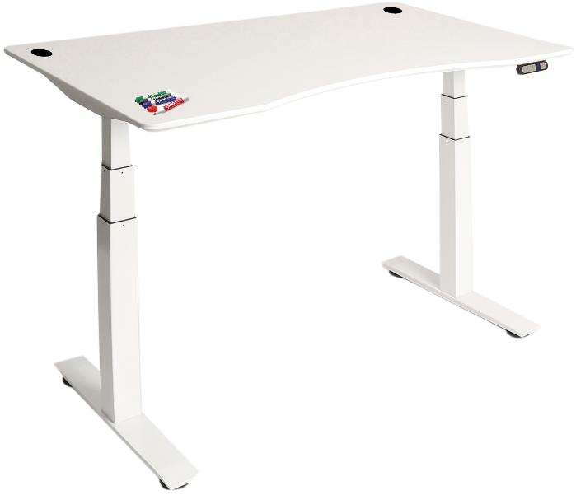
Frame Model: OFF65815
Frame + Top MSRP: $529.99
AIRLIFT® S3 Electric Height-Adjustable Standing Desk with
Ergo Table Top with Beveled Bottom Edges, 54" x 30"
Dry-Erase
Specifications
Top Size: 54" x 30"
Frame Color: White
Does not include weight of top

Slide 15
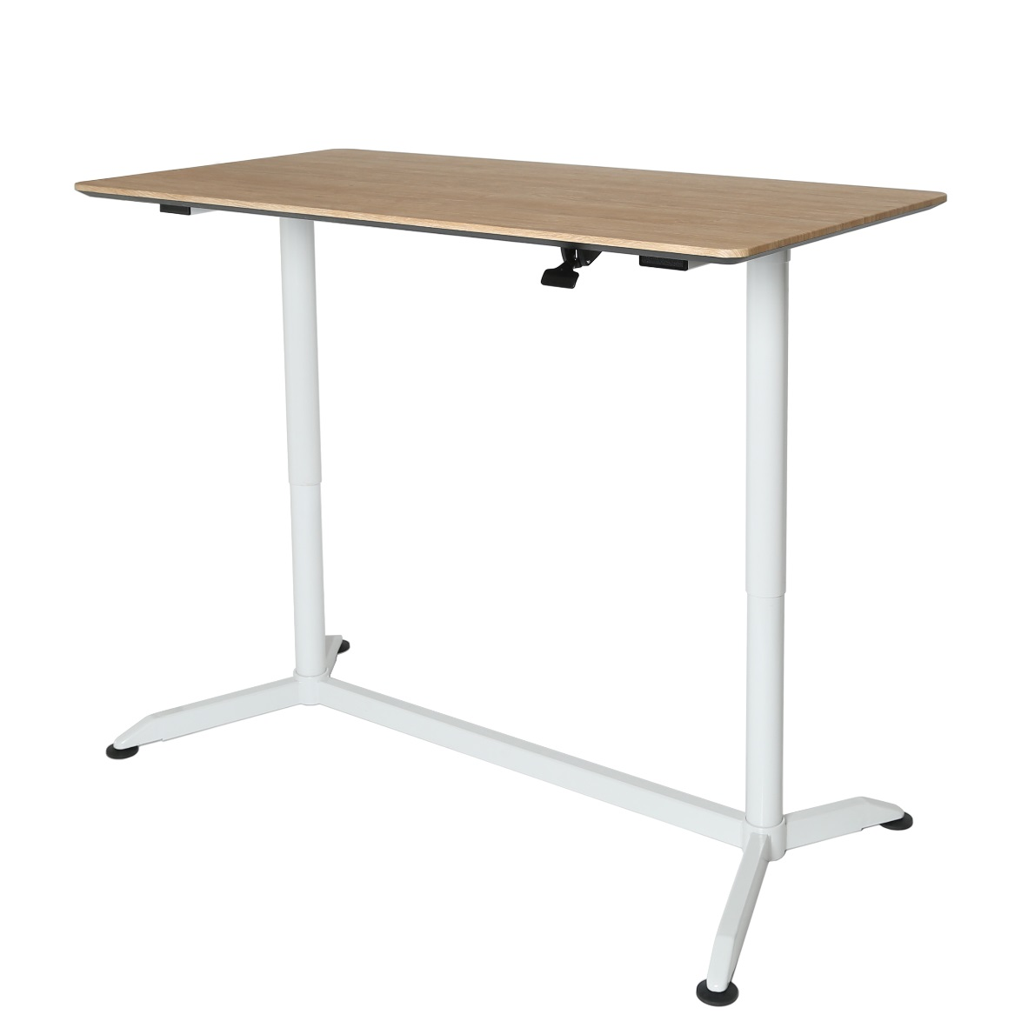
Model: OFF16020
MSRP: $339.99
AIRLIFT® Pneumatic Height-Adjustable Standing Desk
Features
Extra-large desktop with smooth surface
Effortless pneumatic height adjustment with lever-operated gas-air cylinder
Steel base with a silver finish
Four 2.36-inch casters (2 locking) make it easy to take your work with you
Specifications
Top Material: MDF with laminate finish
Top Area: 55.1" W x 27.6" D
Frame Color: Silver
Adjustment Type: Pneumatic
Adjustment Range: 28.1" to 43.9"
Overall Size: 55.1" W x 27.6" D x (28.1" to 43.9")

Slide 16
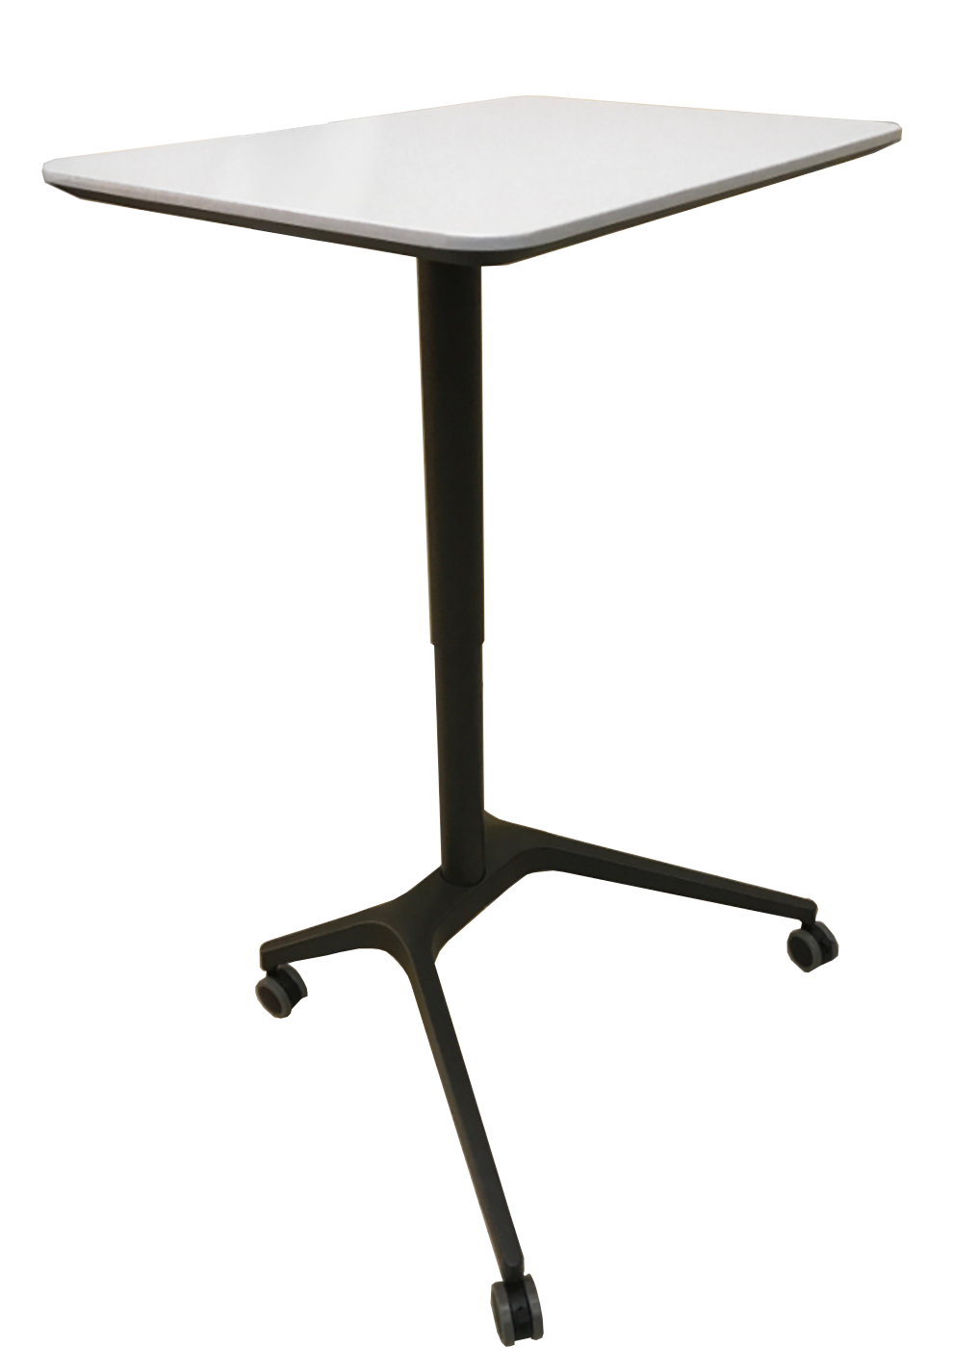
Model: TBD
MSRP: $199.99
AIRLIFT® XL Sit-Stand Mobile Desk
Features
Extra-large desktop with smooth surface
Effortless pneumatic height adjustment with lever-operated gas-air cylinder
Steel base and aluminum column coated in silver epoxy
Wide base provides wobble-free use
Four 2.36-inch casters (2 locking) make it easy to take your work with you
Specifications
Top Material: MDF with laminate finish
Top Area: 28.1" W x 19.6" D
Top Color: Light Gray
Frame Color: Satin Bronze
Adjustment Type: Pneumatic
Adjustment Range: 27.1" to 41.9" H
Overall Size: 28.1" W x 19.6" D x (27.1" to 41.9") H
Weight Capacity: 35 lbs.

Slide 17
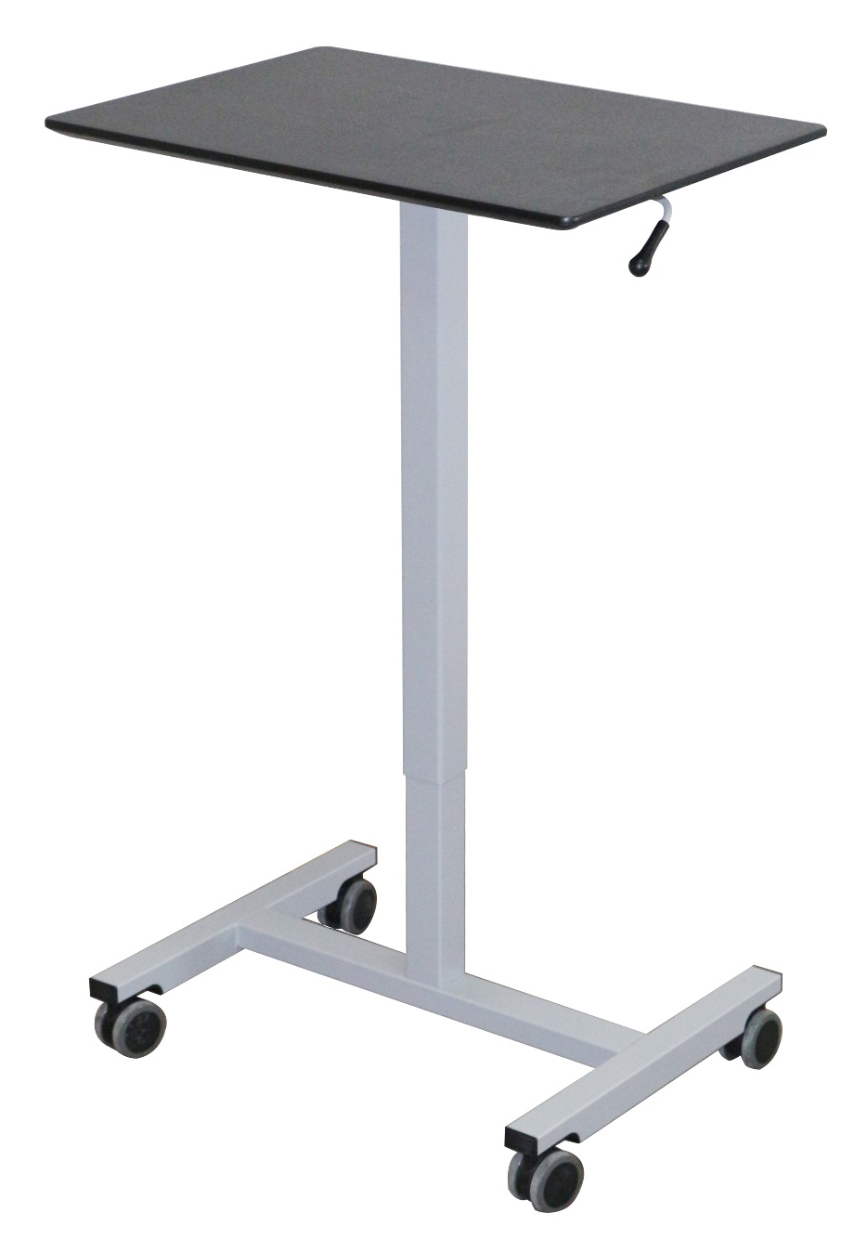
Model: OFF65810
MSRP: $89.99
AIRLIFT® Pneumatic Laptop Mobile Desk Cart
Features
Large desktop with solid black finish
Beveled desktop edges with rounded corners
Effortless pneumatic height adjustment with lever-operated gas-air cylinder
Steel frame powder-coated in satin pewter epoxy
Wide rectangular base provides wobble-free use
Four 2.36-inch casters (2 locking) make it easy to take your work with you
Specifications
Top Material: MDF with laminate finish
Top Area: 24.4" W x 16.9" D
Top Color: Black
Frame Color: Satin Pewter
Adjustment Type: Pneumatic
Adjustment Range: 29.3" to 43.5" H
Overall Size: 24.4" W x 16.9" D x (29.3" to 43.5" H)
Weight Capacity: 35 lbs.
AIRLIFT® Adjustment Lever

Slide 18
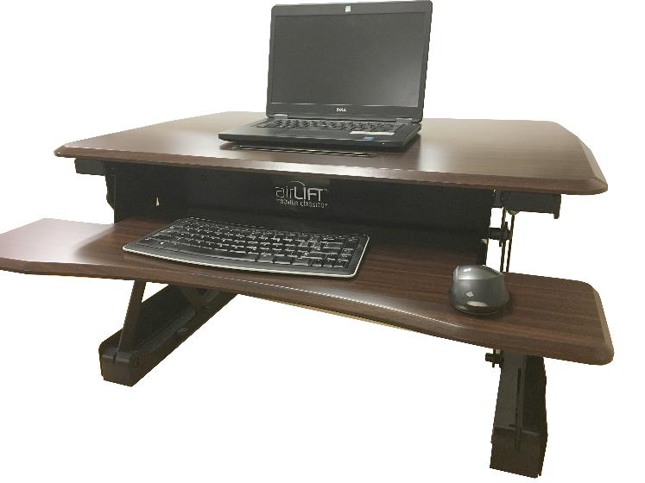
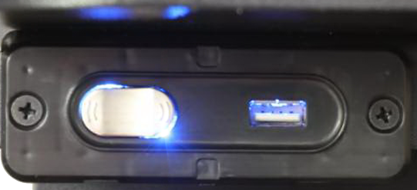

Model: OFF65833
MSRP: $299.99
AIRLIFT® Electric Standing Desk Converter
Features
Turns any flat surface into an adjustable height workspace
Provides more than 11 inches of vertical height adjustment!
Electric drive system lifts up to 33 lbs. with the touch of a button
5V2.1A/10W USB port charges USB devices from phone chargers, to mini fans and other gadgets
Generous desk top surface measures 35.43" x 23.23"; fits almost any size laptop and multiple monitor setups
Conveniently store tablets and cell phones in the desk top slot for easy access and use as a second screen
Ergonomically beveled edges provide a comfortable resting place for the heel of your hand
Removable keyboard tray adjusts with desk top
No assembly required; simply unpack and plug in
Specifications
Top Material: MDF with laminate finish
Top Area: 35.43" x 23.23" x 0.59" thick
Tray Area: 35.4" x 12.6" x 0.59" thick
Top Color: Walnut
Frame Color: Black
Adjustment Type: Electric Motor
Adjustment Range: 5.9" to 18.9"
Overall Size: 35.43" W x 31.3" D x (5.9" to 18.9") H
USB-A Ports: 1 @ 5V/2.1A
Weight Capacity: 33 lbs.
Weight: 50.7 lbs.
Update image with COSTCO VERSION
Walnut

Slide 19
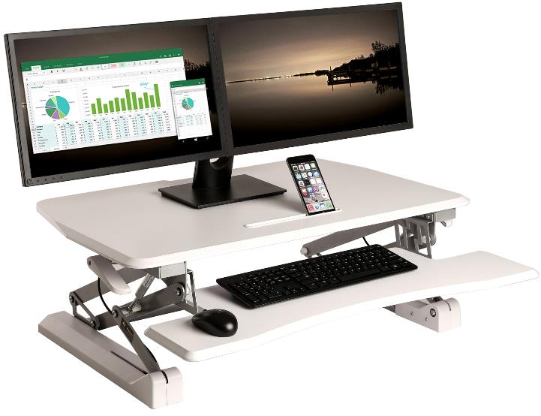
Model: OFF65808
MSRP: $199.99
AIRLIFT® Pneumatic Standing Desk Converter
Features
Turns any flat surface into an adjustable height workspace
Pneumatic and spring system lifts up to 33 lbs. smoothly
Provides nearly 13.8 inches of vertical height adjustment!
Generous desk top surface measures 35.43" x 23.23"; fits almost any size laptop and multiple monitor setups
Conveniently store tablets and cell phones in the desk top slot for easy access and use as a second screen
Self contained design saves space by adjusting height vertically
Ergonomically beveled edges provide a comfortable resting place for the heel of your hand
Removable keyboard tray adjusts with desk top
No assembly, no buttons, no plugs; simply unpack and work
Specifications
Top Material: MDF with laminate finish
Top Area: 35.43" x 23.23" x 0.59" thick
Tray Area: 35.4" x 12.6" x 0.59" thick
Top Color: White
Frame Color: Silver
Adjustment Type: Pneumatic
Adjustment Range: 5.9" to 19.7"
Overall Size: 35.43" W x 35.8" D x (5.9" to 19.13") H
Weight Capacity: 33 lbs.
Weight: 52.3 lbs.

Slide 20
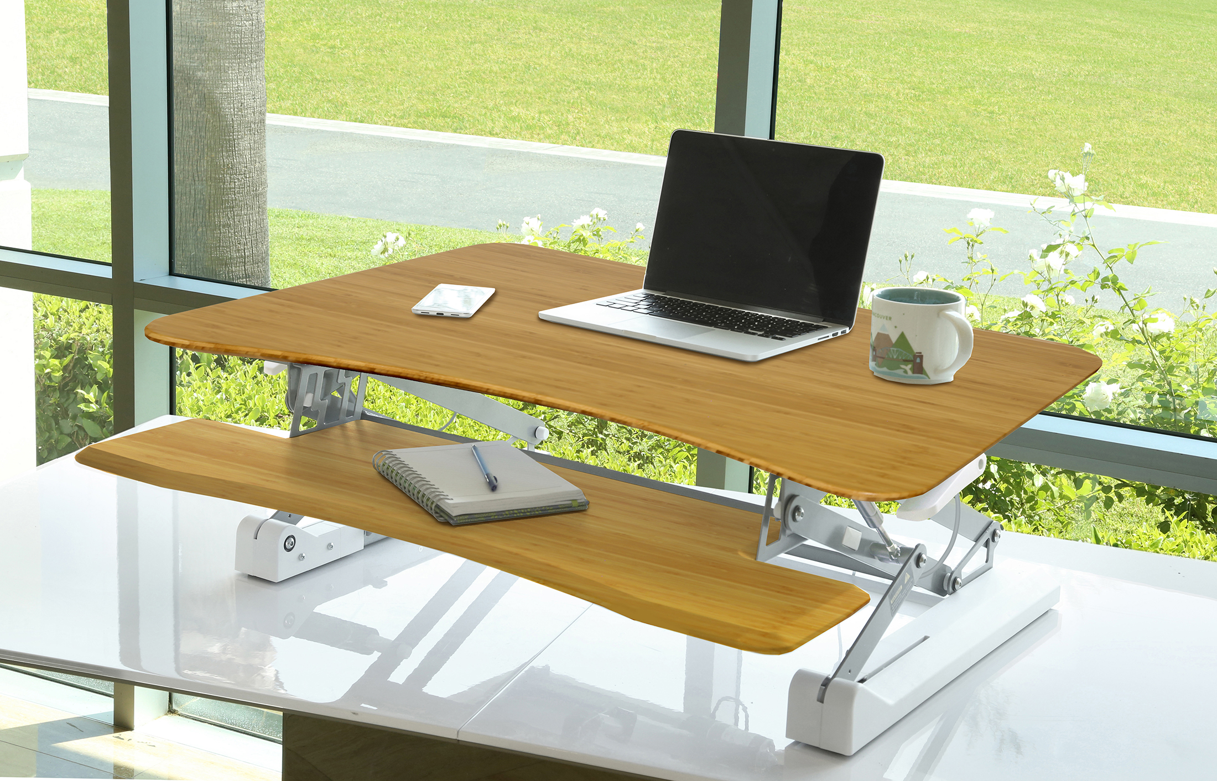
Model: OFF65808
MSRP: $249.99
AIRLIFT® Pneumatic Standing Desk Converter
Features
Turns any flat surface into an adjustable height workspace
Pneumatic and spring system lifts up to 33 lbs. smoothly
Provides nearly 13.8 inches of vertical height adjustment!
Generous desk top surface measures 35.43" x 23.23"; fits almost any size laptop and multiple monitor setups
Self contained design saves space by adjusting height vertically
Ergonomically beveled edges provide a comfortable resting place for the heel of your hand
Removable keyboard tray adjusts with desk top
No assembly, no buttons, no plugs; simply unpack and work
Specifications
Top Material: Bamboo
Top Area: 35.43" x 23.23" x 0.59" thick
Tray Area: 35.4" x 12.6" x 0.59" thick
Top Color: Bamboo
Frame Color: White
Adjustment Type: Pneumatic
Adjustment Range: 5.9" to 19.7"
Overall Size: 35.43" W x 35.8" D x (5.9" to 19.13") H
Weight Capacity: 33 lbs.
Weight: 52.3 lbs.
Update image with COSTCO VERSION
Bamboo

Slide 21
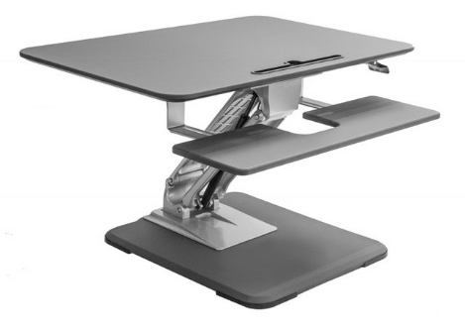
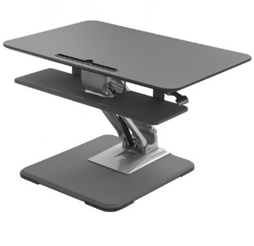
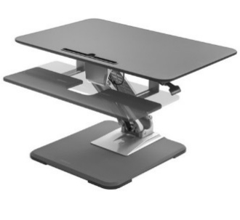

Model: OFF65841
MSRP: $179.99
AIRLIFT® Lite Pneumatic Standing Desk Converter Riser
Features
Turns any flat surface into an adjustable height workspace
Provides 11 inches of vertical height adjustment!
Compact desk top surface measures 30.7" x 20.5"; fits almost any size laptop and multiple monitor setups
Retractable keyboard tray slides in and out as needed
Aluminum frame keeps the desk lightweight
Ergonomic design moves towards you as it rises
Beveled edges provide a comfortable resting place for the heel of your hand
No assembly, no buttons, no plugs; simply unpack and work
Rubber padded base prevents moving when in use
Specifications
Top Material: MDF with laminate finish
Height Adjustment Range: 6.9" to 17.9"
Top Area: 30.7" W x 18.9" D
Keyboard Tray Size: 30.7" x 7.87" D
Top Color: Slate Gray
Frame Color: Silver
Frame Material: Aluminum
Adjustment Type: Pneumatic
Overall Size: 30.7" x (20.5" to 27.2") x (6.9" to 17.9")
Base Size: 18" x 19"
Weight: 48.4 lbs.

Slide 22
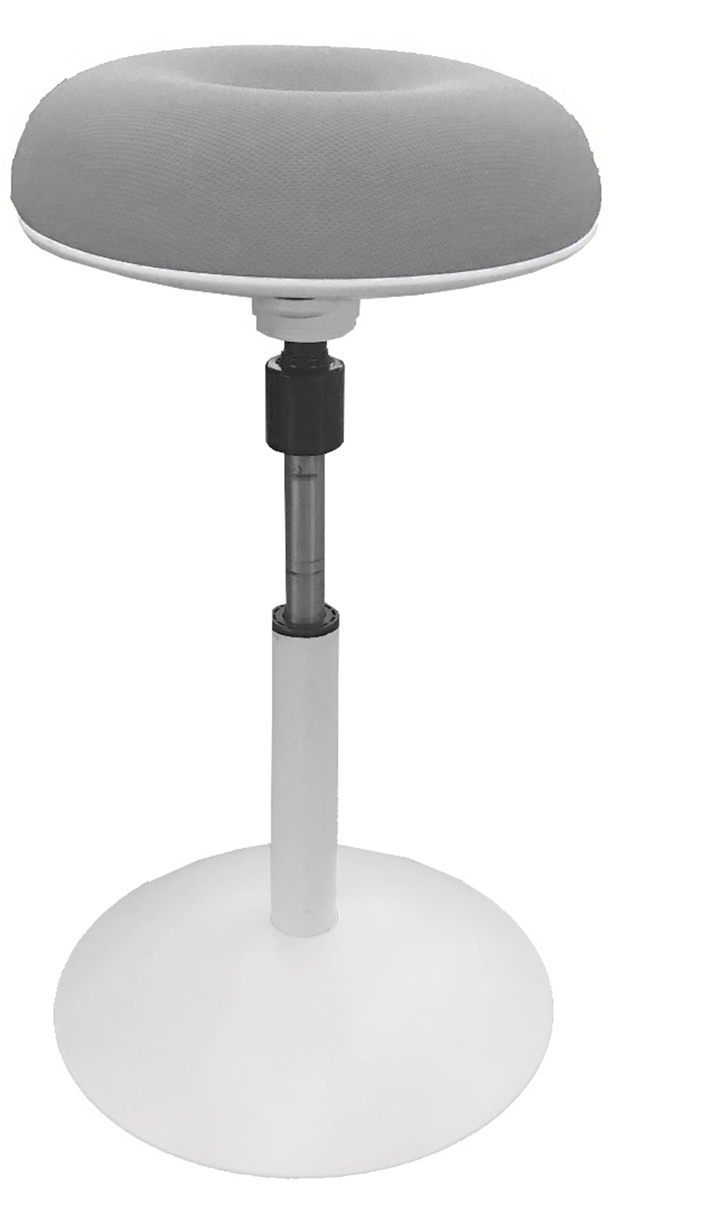
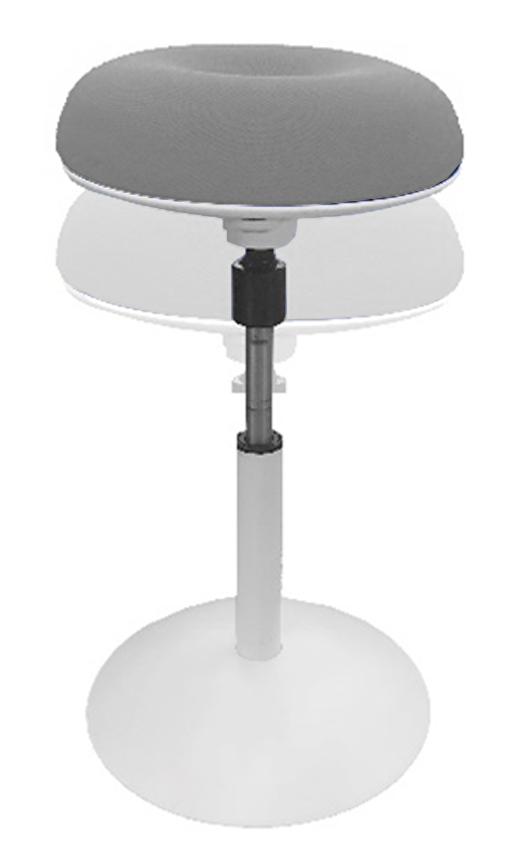
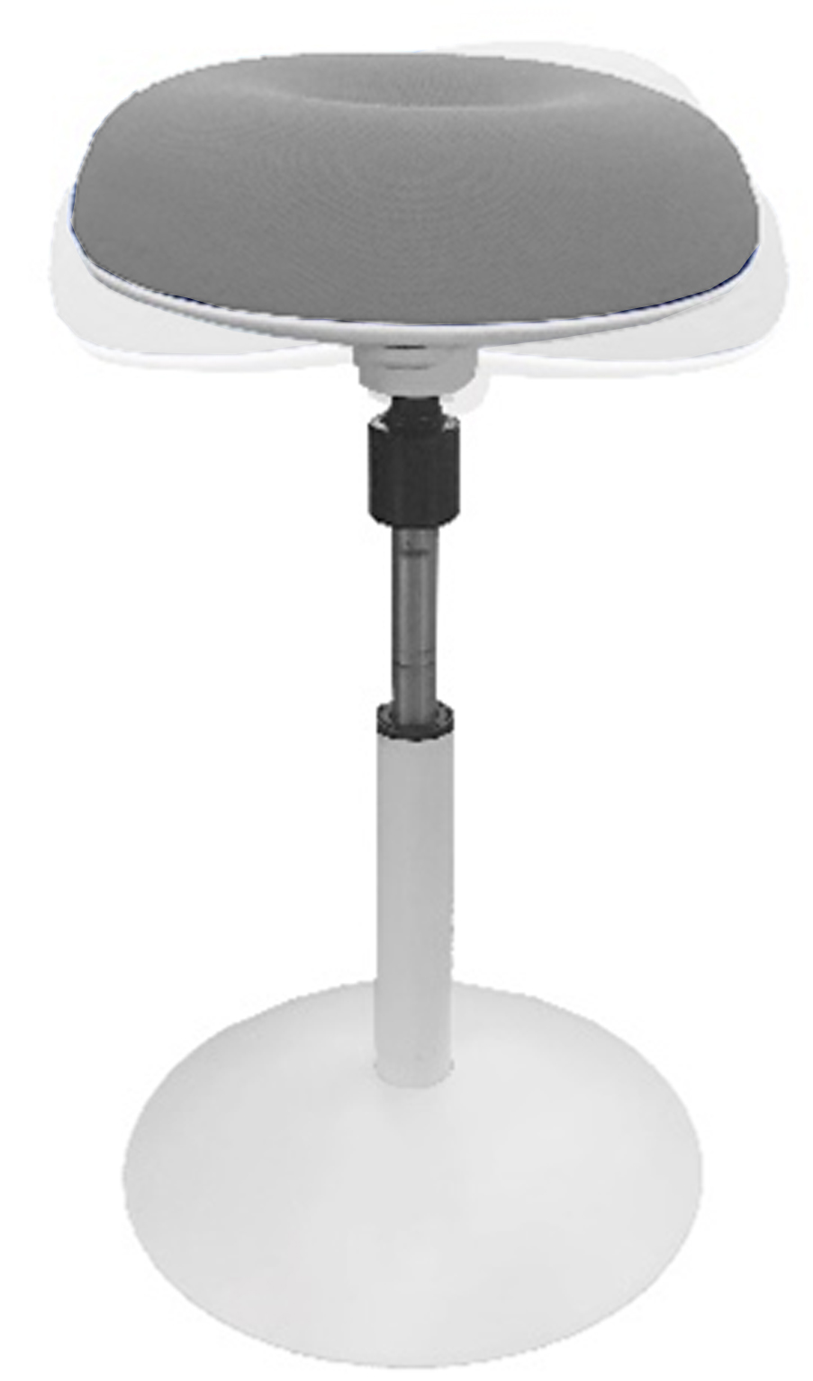
Model: TBD
MSRP: $69.99
Seville Classics Ergo Work Stool
Features
Semi-study stool keeps you moving while giving your feet time to rest
Plush foam seat cushion with elastic polyester cover
Designed to wobble left, right, back and front and rotate 360 degrees so you can stay active while you sit
Holds up to 300 lbs.
Specifications
Seat Material: Elastic polyester mesh
Seat Area: 13.8" diameter x 3.1" thick
Seat Color: Gray*
Frame Color: White*
Adjustment Type: Pneumatic
Adjustment Range: 23.2" to 29.5" H
Overall Size: 15.4" W x 15.4" D x 23.2" up to 29.5" H
Weight Capacity: 300 lbs.
Weight: 13 lbs.
*Alternate colors available with MOQs

Slide 23
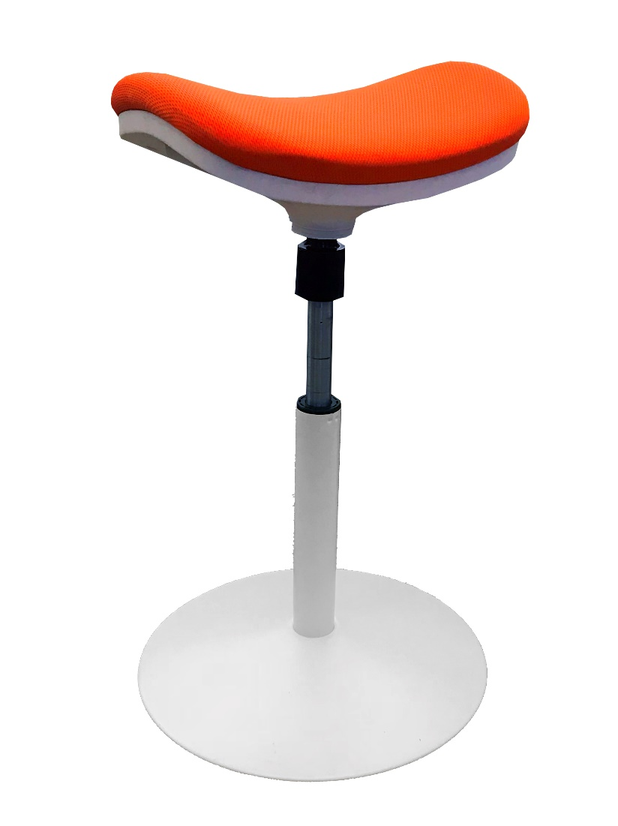
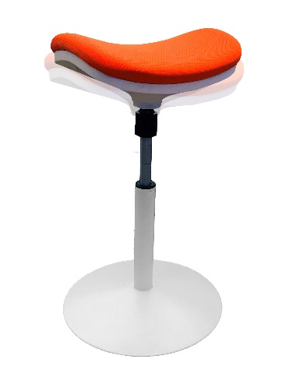
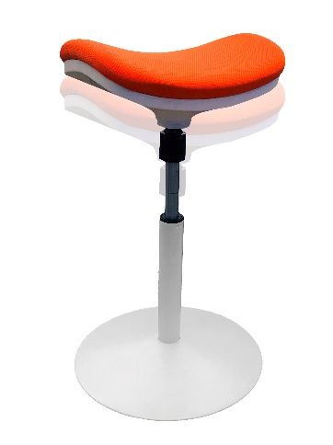
Model: TBD
MSRP: $69.99
Seville Classics Ergo Work Bench
Features
Semi-study stool keeps you moving while giving your feet time to rest
Plush inflatable seat cushion with elastic polyester cover
Designed to wobble left, right, back and front and rotate 360 degrees so you can stay active while you sit
Industrial-strength steel frame in white
Holds up to 300 lbs.
Specifications
Seat Material: Elastic polyester mesh
Seat Area: 16.1" W x 10.2" D x 1.5" thick
Seat Color: Orange*
Frame Color: White*
Adjustment Type: Pneumatic
Adjustment Range: 24" to 30.3" H
Overall Size: 16.5" W x 16.5" D x 24" up to 30.3" H
Weight Capacity: 300 lbs.
Weight: 11.5 lbs.
*Alternate colors available with MOQs

Slide 24
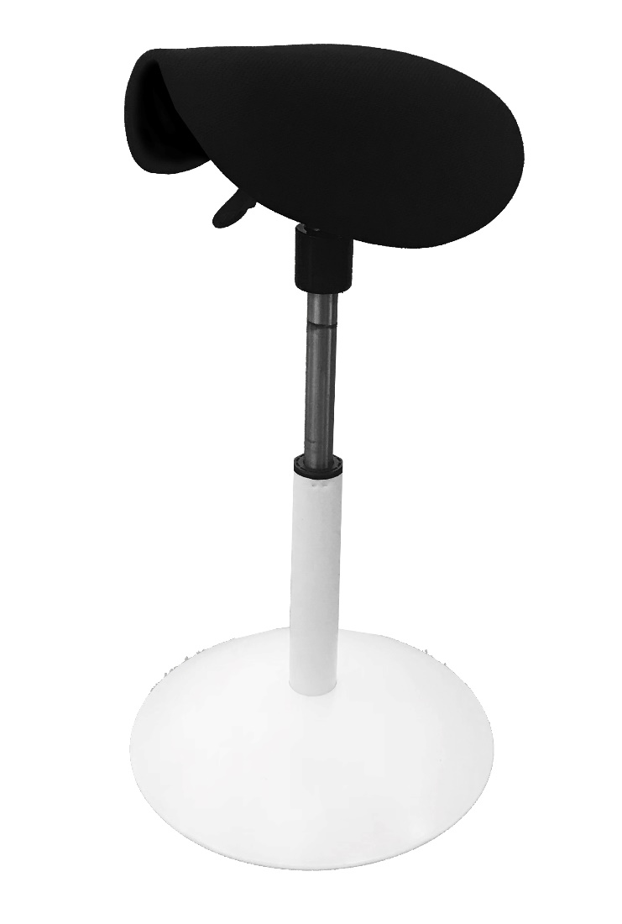
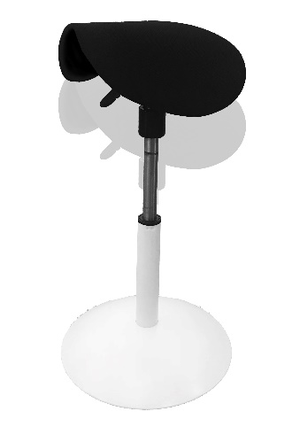

Model: TBD
MSRP: $69.99
Seville Classics Ergo Saddle
Features
Semi-study stool keeps you moving while giving your feet time to rest
Plush inflatable seat cushion with elastic polyester cover
Designed to wobble left, right, back and front and rotate 360 degrees so you can stay active while you sit
Industrial-strength steel frame in white
Holds up to 300 lbs.
Specifications
Seat Material: Elastic polyester mesh
Seat Area: 13.8" W x 12.2" D x 1.5" thick
Seat Color: Black*
Frame Color: White*
Adjustment Type: Pneumatic
Adjustment Range: 23.6" to 28.7" H
Overall Size: 15.4" W x 15.4" D x 23.6" up to 28.7" H
Weight Capacity: 300 lbs.
Weight: 11.5 lbs.
*Alternate colors available with MOQs

Slide 25
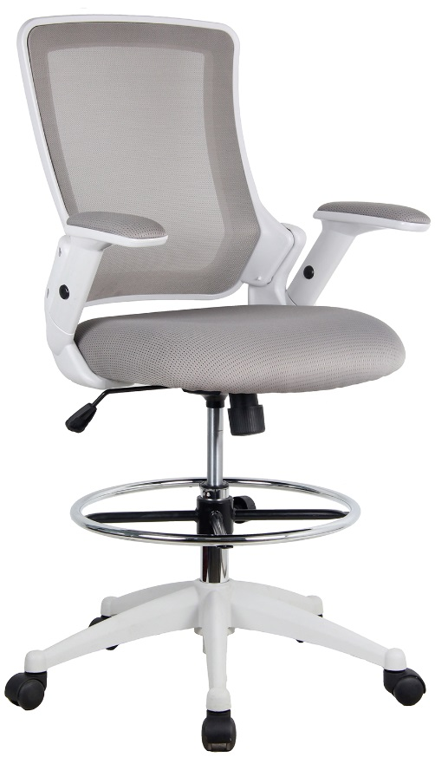
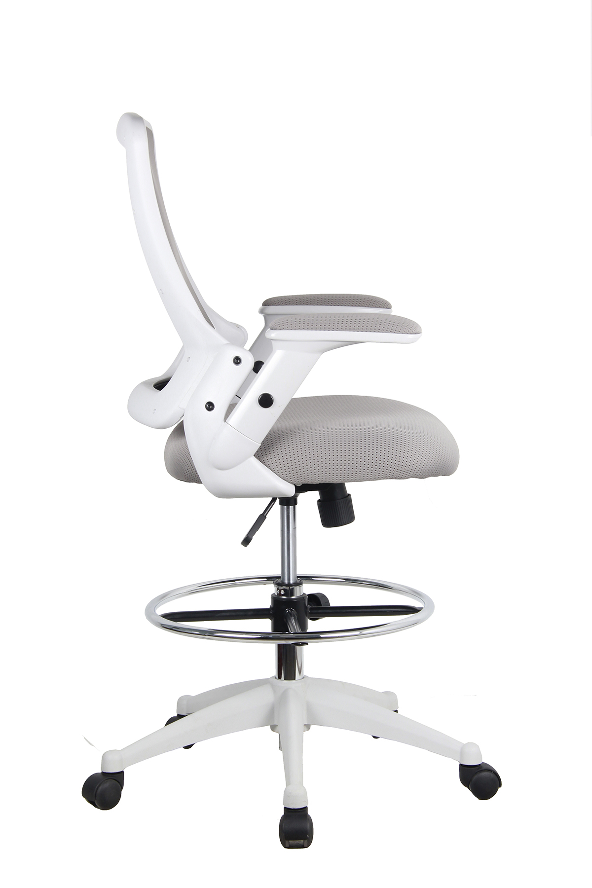
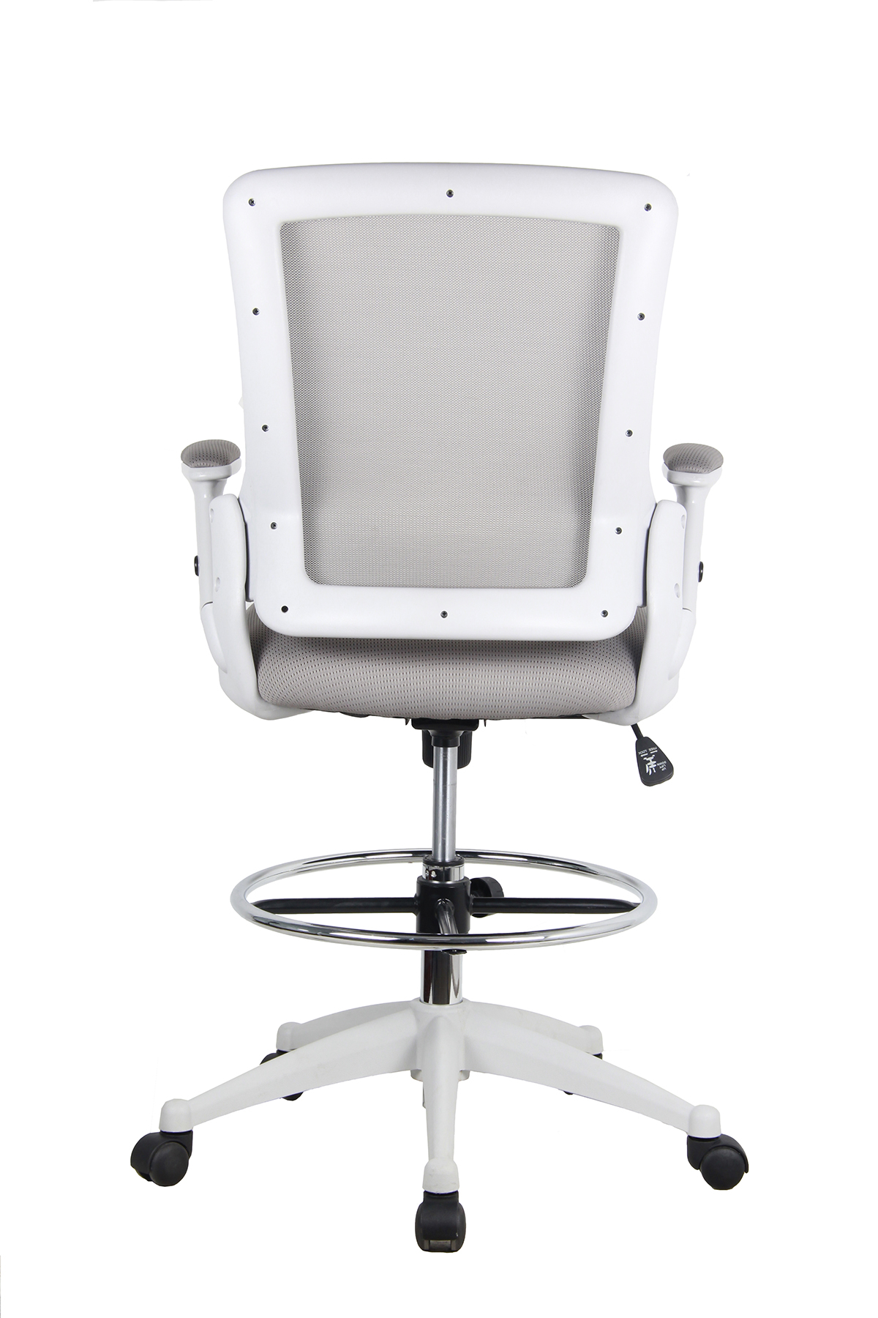
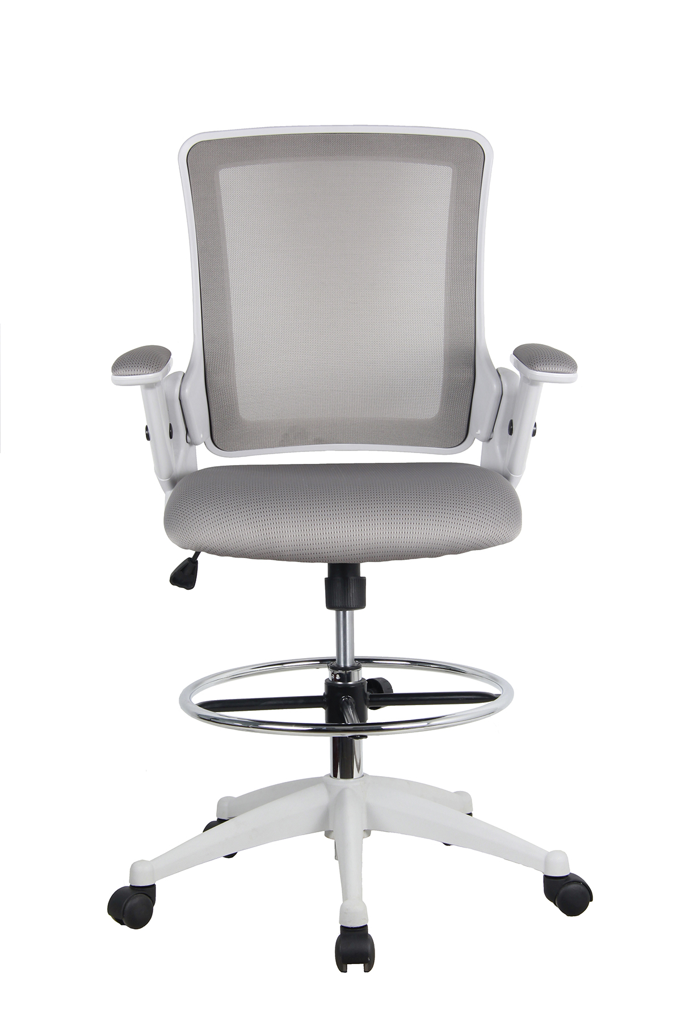
Model: TBD
MSRP: $139.99
Seville Classics Sit-Stand Ergo Chair
Features
Pneumatic height-adjustment with built in AIRLIFT® technology
Plush seat cushion with elastic polyester cover
Breathable mesh seat back
Height adjustable chair arms can be lifted and lowered manually
Industrial-strength steel frame in white
Specifications
Seat Material: Elastic polyester mesh
Seat Color: Gray
Frame Color: White
Adjustment Type: Pneumatic
AIRLIFT® Adjustment Lever

Slide 26
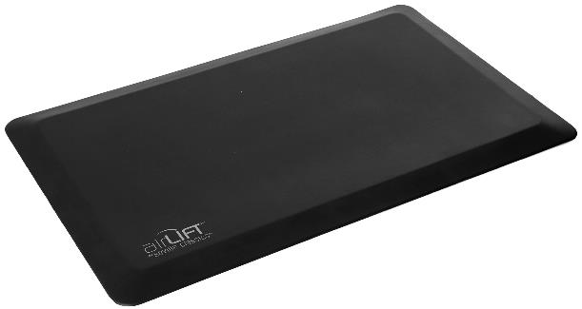
Model: MSC55929B, MSC55930B
MSRP: $29.99
Seville Classics Anti-Fatigue Comfort Mat
Features
Premium 100% polyurethane construction
Viscoelastic material is able to stretch, bend, fold while returning to it's original shape
Non-slip base features ridges that keep the mat from sliding on slick and occasionally wet surfaces
Beveled edges designed to prevent tripping and accidents
Curl resistant edges keep the corners of the mat flat
Completely non-toxic!
Measures 32" x 20" .7" thick
Specifications
Material: Polyurethane foam
Top Area: 32" x 20"
Color: Black, Gray
Overall Size: 32" x 20" x .7" thick
Weight: 23 lbs. per mat
Black (MSC55929B)
Gray (MSC55930B)

Slide 27
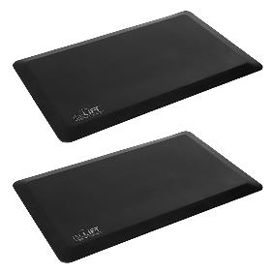
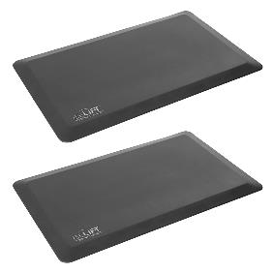
Model: MSC55931B, MSC55932B MSRP: $59.99
Seville Classics Anti-Fatigue Comfort Mat (2-Pack)
Features
Premium 100% polyurethane construction
Viscoelastic material is able to stretch, bend, fold while returning to it's original shape
Non-slip base features ridges that keep the mat from sliding on slick and occasionally wet surfaces
Beveled edges designed to prevent tripping and accidents
Curl resistant edges keep the corners of the mat flat
Completely non-toxic!
Measures 32" x 20" .7" thick
Specifications
Material: Polyurethane foam
Top Area: 32" x 20"
Color: Black, Gray
Overall Size: 32" x 20" x .7" thick
Weight: 23 lbs. per mat
Black 2-Pack
(MSC55931B)
Gray 2-Pack
(MSC55932B)

Slide 28
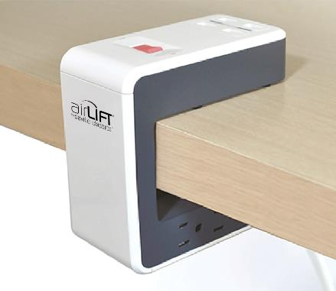
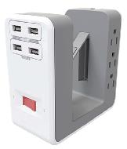
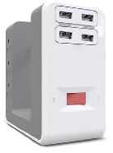
Model: TBD
MSRP: $39.99
Clip-On Surge Protector
Features
Unique "clip-on" design attaches easily to any desk top or office cubicle wall
Includes 6 grounded AC outlets to power your workspace
2 pair of USB-A chargers output a total of 5V at 4.8A per pair
Rotating power cord lets users attach the protector to any side of the desk while minimizing tangles
Protects electronics up to a surge of 1080 joules
Specifications
Grounded Outlets: 6 @ 110-120V
USB-A Ports: 2 pairs, 4 total
USB-A Power: 5V/4.8A shared per pair
Surge Protection: 1080J

Slide 29
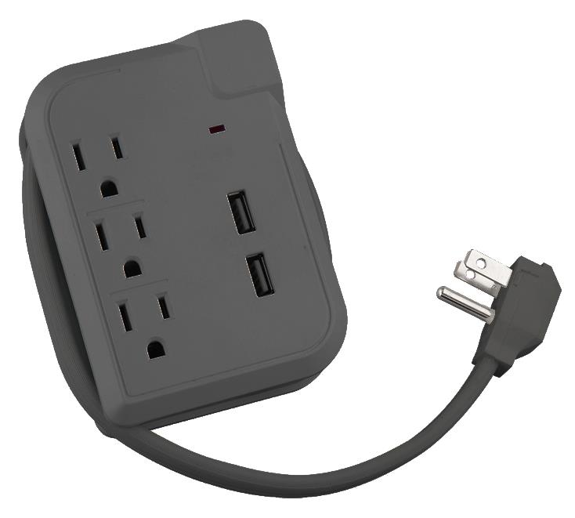
Model: TBD
MSRP: $19.99
Block Surge Protector
Features
Three grounded power outlets keep your electronics powered
Compact size can be installed easily almost anywhere
Power cable wraps around the block for easy organization
USB-A ports let you charge up to 2 devices simultaneously at a maximum power output of 3.1A
LED indicator lets users know their devices are protected
Protects electronics up to a surge of 300 joules
6 foot power cord
Specifications
Grounded Outlets: 3 @ 125V
USB-A Ports: 2 @ 3.1A overall
Surge Protection: 300J

Slide 30
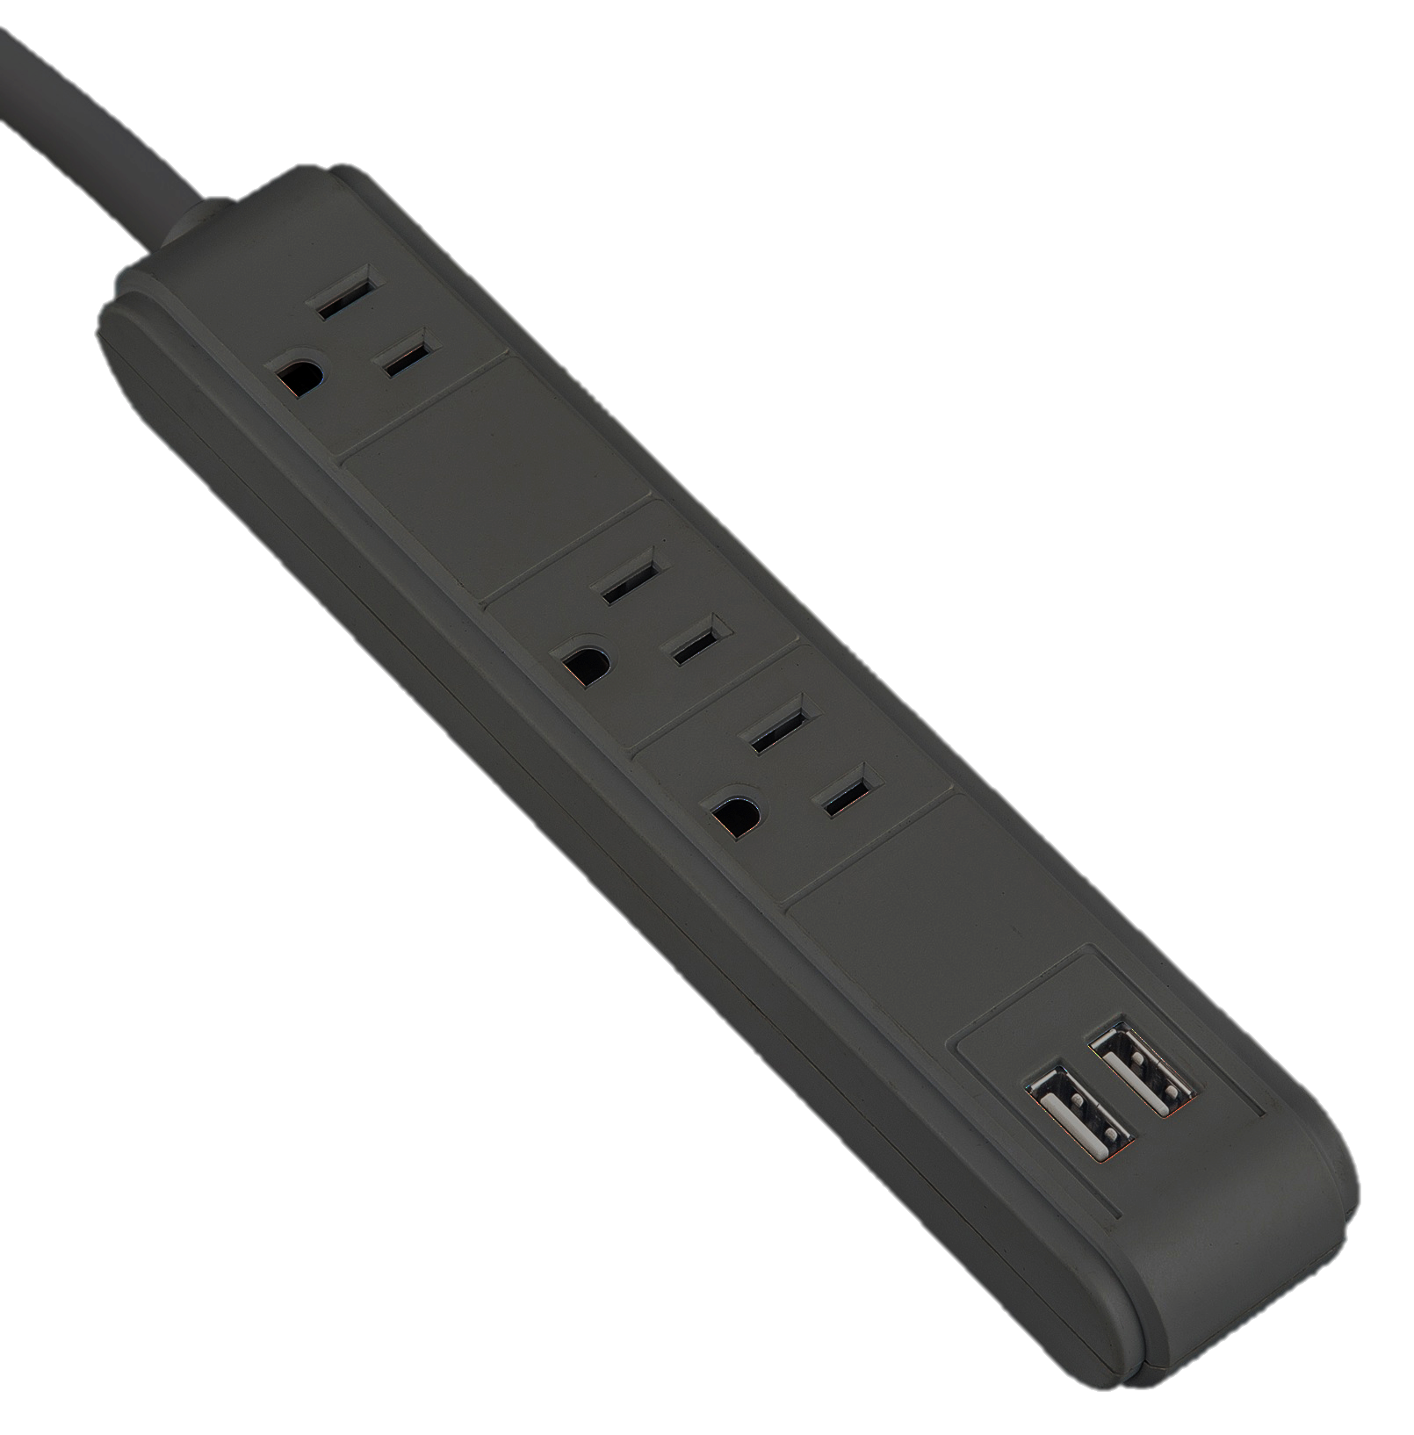
Model: TBD
MSRP: $19.99
Power Strip Surge Protector
Features
Three grounded power outlets keep your electronics powered
Designed to conveniently fit bulky AC adapters
USB-A ports let you charge up to 2 devices simultaneously at a maximum power output of 3.1A
LED indicator lets users know their devices are protected
Protects electronics up to a surge of 300 joules
6 foot power cord
Specifications
Grounded Outlets: 3 @ 125V
USB-A Ports: 2 @ 3.1A overall
Surge Protection: 300J

Slide 31

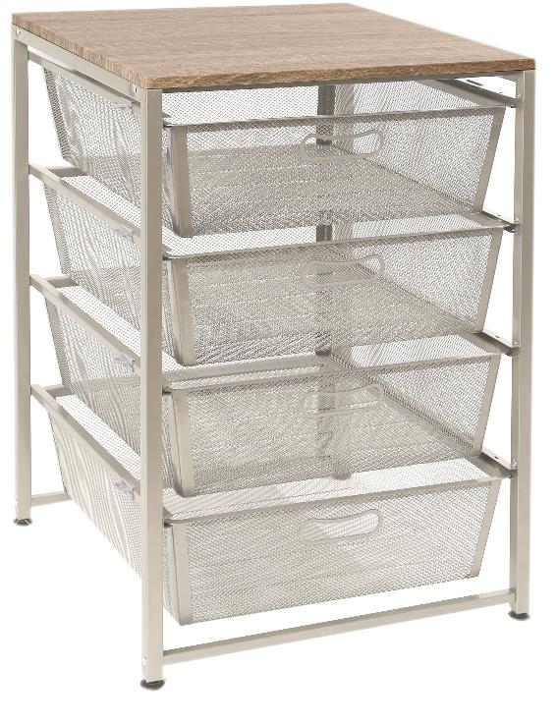
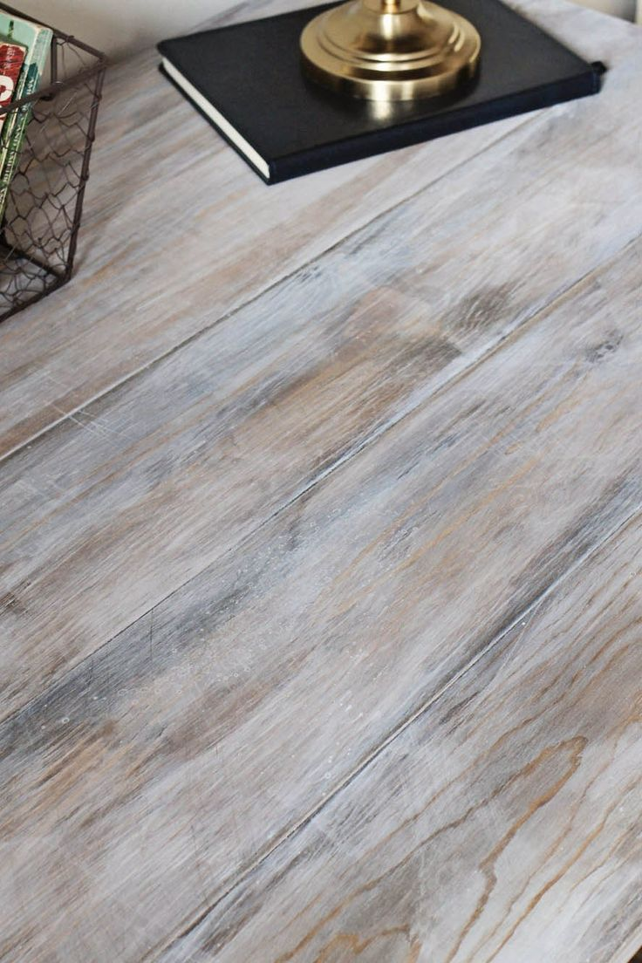
Model: SHE16227
MSRP: $64.99
4-Drawer Steel Mesh Drawer Organizer
Features
Diamond mesh drawers for ventilation and easy visibility
Reinforced handles, drawer corners and with ridged mesh
Medium-density fiberboard wood top with weathered finish
Industrial-strength steel construction
Off-white powder coat finish
Screw-in padded leveling feet
Assembly is easy with only a few parts; no drilling required
Specifications
Top Material: MDF with weathered wood finish
Top Area: 19.3" W x 19" D
Color: Satin white
Overall Size: 19.3" W x 19" D x 27.4" H
Weight Capacity: 15 lbs.
Weathered wood

Slide 32

Model: WEB488
MSRP: $TBD
6-Drawer Steel Mesh Organizer Cart
Features
Heavy-duty tubular steel construction for strength and stability
Diamond wire mesh drawers keep drawer contents visible
Removable drawers with built in handles
Clip on drawer labels let you organize your way
Large wheels let your work go where you do
Perforated top shelf provides a convenient mobile work surface
Tall handles make it easy to push and pull
Specifications
Material: Steel
Color: Satin Pewter
Overall Size: 12.6" W x 15.35" D x 37" H
Weight Capacity: 110 lbs.

Slide 33



Model: TBD MSRP: $249.99
Under-The-Table Cabinet (36" x 18.1")
Features
Cushion top makes an excellent seat when needed
Mixed size drawers let you get organized
All-steel construction
Chrome drawer handles for easy access
Keyed lock keeps things secure when you're not around
Rubber casters with 2 locking
Specifications
Top Material: Plush cushion
Top Area: 36" W x 18.1" D
Cabinet Material: Steel
Color: White
Overall Size: 36" W x 18.125" D x 21" H (with cushion 22.75" H)

Slide 34



Model: TBD MSRP: $179.99
Under-The-Table Cabinet (16" x 18.1")
Features
Cushion top makes an excellent seat when needed
Mixed size drawers let you get organized
All-steel construction
Chrome drawer handles for easy access
Keyed lock keeps things secure when you're not around
Rubber casters with 2 locking
Specifications
Top Material: Plush cushion
Top Area: 16" W x 18.1" D
Cabinet Material: Steel
Color: White
Overall Size: 16" W x 18.125" D x 21" H (with cushion 22.75" H)

